Slide 1


Department of Computer Science and Engineering
AI-Based Emergency Call Prioritization and Classification System
Mrs. M.Divya ,
Department of CSE ,
Rajalakshmi Engineering College Chennai,India .
divya.m@rajalakshmi.edu.in
M.S.Sakthi,
Department of CSE ,
Rajalakshmi Engineering College ,
Chen 220701240@rajalakshmi.edu.in
nai,India.

Slide 2
Problem Statement and Motivation
Emergency response systems are critical, yet many still rely on manual triaging by operators. These operators are often overwhelmed by a high volume of calls during disasters or peak hours. As a result, response times are delayed, and some critical cases go unnoticed. Moreover, language barriers, unclear speech, and panic from callers further complicate manual interpretation. There's a clear need for a system that can quickly and accurately process distress messages, detect their urgency and type, and act accordingly.
Our motivation is to leverage Machine Learning to automatically classify and prioritize emergency calls based on urgency and type. By integrating speech recognition, multilingual translation, and real-time geolocation, we aim to reduce response times and improve emergency handling efficiency across varied user groups.

Slide 3
Existing System
The current emergency systems are limited in several ways:
Manual triage: Each call must be interpreted by a human, leading to delays.
Language dependency: Most systems lack support for regional or foreign languages.
Lack of automation: No prioritization logic exists to classify emergencies.
No GPS integration: Location is often unclear unless explicitly mentioned by the caller.
Operator overload: In high-stress scenarios, critical cases may be ignored unintentionally. These challenges highlight the need for a system that incorporates speech, NLP, and automation.

Slide 4
Objectives
Build an ML-based system to classify messages as High, Medium, or Low priority.
Identify emergency types: Fire, Crime, Medical, or Other.
Accept both typed and spoken input to make the system accessible to all users.
Translate regional or foreign language messages into English using Google Translate API.
Extract GPS coordinates using browser permissions to detect caller location.
Send email alerts automatically to relevant departments.
Display results and emergency logs using a real-time dashboard (Streamlit).

Slide 5
Abstract
This project implements an AI-based pipeline that accepts emergency inputs in multiple languages and formats (text or voice). The input is translated, cleaned, and then vectorized before being passed to a trained XGBoostClassifier. The model outputs the urgency level and emergency type. The system also uses the browser’s navigator.geolocation to fetch precise user coordinates, which are logged and included in alert messages. The final output is displayed in a browser interface built with Streamlit, which shows the predicted values, confidence level, and logs the event. Alerts are dispatched to fire, medical, or police departments depending on the emergency type. The result is a responsive, fast, and reliable AI assistant for emergency screening.

Slide 6
Proposed System
The system begins by accepting user input via a text box or microphone. If the user speaks, the voice is transcribed using a speech recognition engine. The message, whether typed or spoken, is then translated into English using Google Translate API (if not already in English). The preprocessed message is vectorized and fed into a XGBoostClassifier trained on emergency data. The classifier returns the predicted priority (High/Medium/Low) and emergency type. If the prediction is “High” and type is “Fire”, an email alert is generated and sent automatically to a simulated fire department email. The user’s GPS location is captured using browser permissions, visualized on Google Maps, and logged along with the message and prediction. All past events are displayed in a real-time emergency queue table, filterable by type and priority.

Slide 7
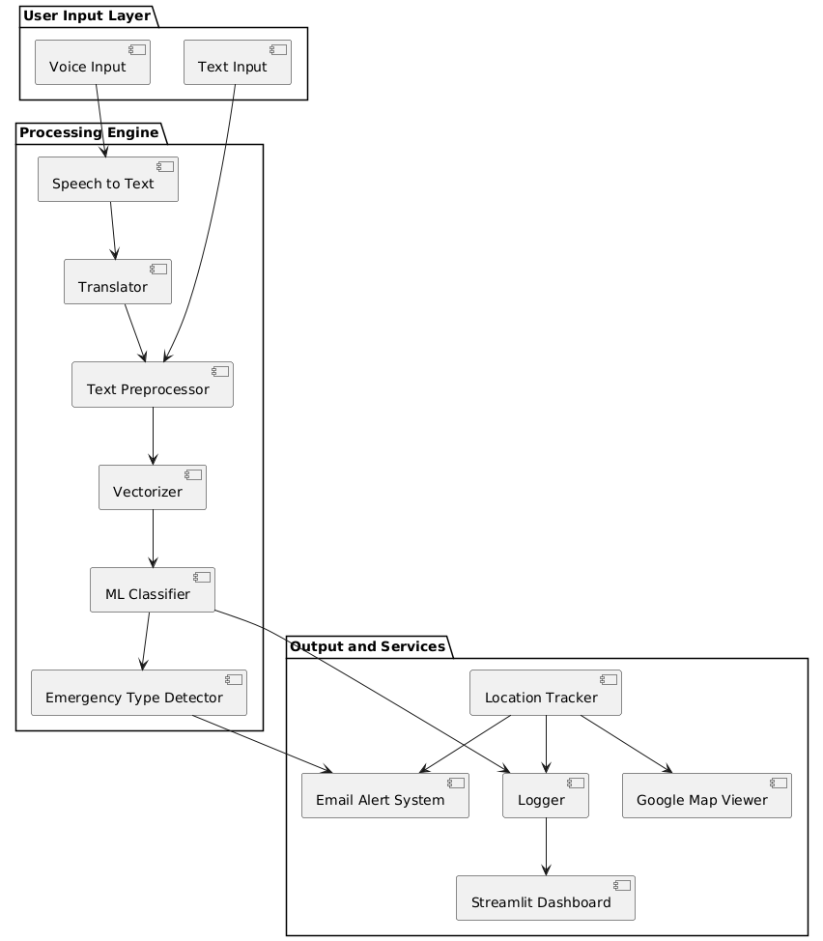
System Architecture

Slide 8
List of Modules
Input Module: Collects either typed or spoken emergency messages.
Voice Transcription Module: Converts spoken messages into text using Google’s speech recognition.
Translation Module: Converts non-English text to English.
Text Cleaning Module: Removes punctuation, stopwords, and converts to lowercase.
Vectorization Module: Transforms text into feature vectors using CountVectorizer.
ML Classifier Module: Applies Naive Bayes to classify message urgency and type.
Location Module: Uses browser API to capture exact GPS coordinates.
Routing Module: Triggers email alerts to corresponding departments.
Logging Module: Writes message data into a structured CSV file.
Dashboard Module: Streamlit-powered UI to display real-time emergency log.

Slide 9
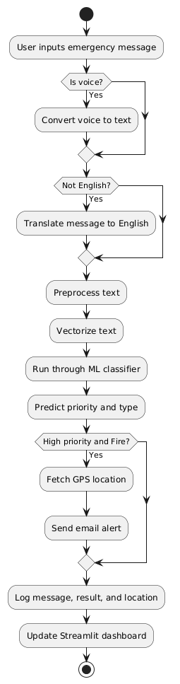
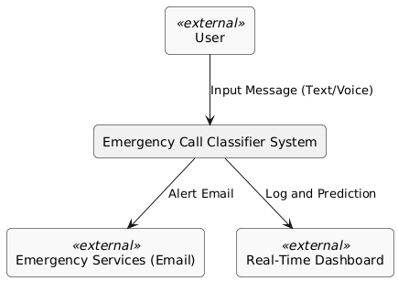
Functional Description for each modules with DFD and Activity Diagram
ACTIVITY DIAGRAM
DFD(LEVEL 0)

Slide 10
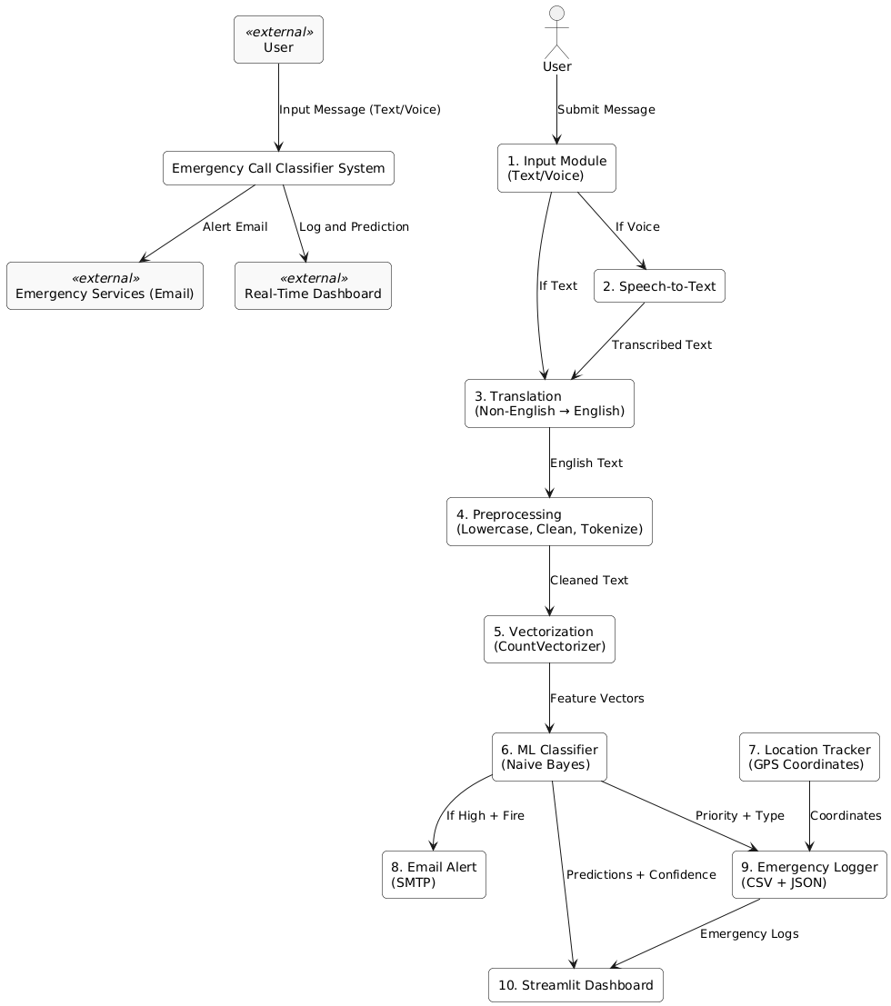
DDF(LEVEL 1)
Process ID | Name | Function
1.0 | Input Module | Accepts user input via text or speech
2.0 | Speech-to-Text | Converts speech to text
3.0 | Translation | Translates to English if needed
4.0 | Preprocessing | Cleans and tokenizes text
5.0 | Vectorization | Converts text to numerical features
6.0 | ML Classifier | Classifies priority and type
7.0 | Email Alert | Sends alert if critical emergency
8.0 | Location Module | Captures GPS coordinates
9.0 | Emergency Logger | Stores message, prediction, and location
10.0 | Dashboard | Displays all logged messages

Slide 11
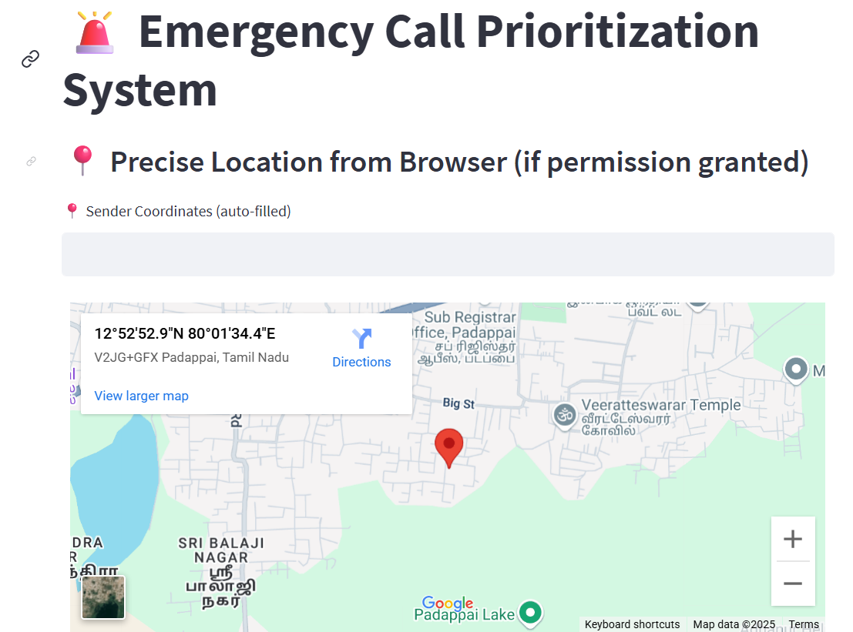
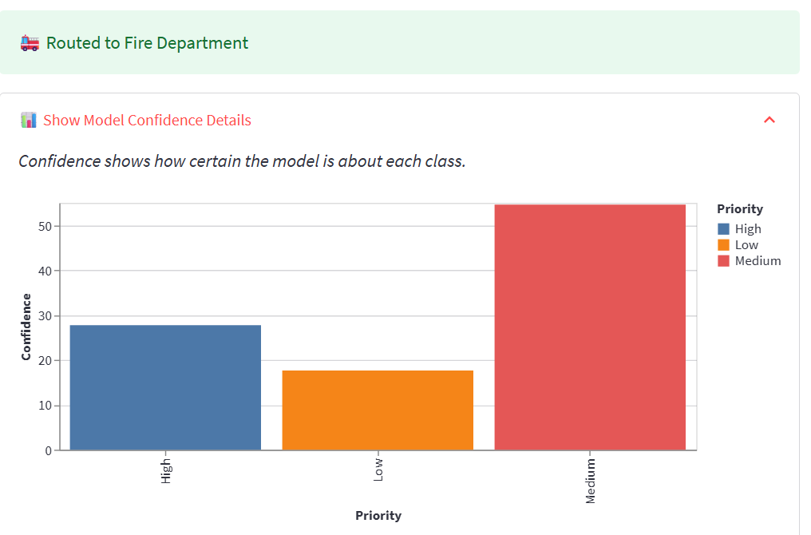
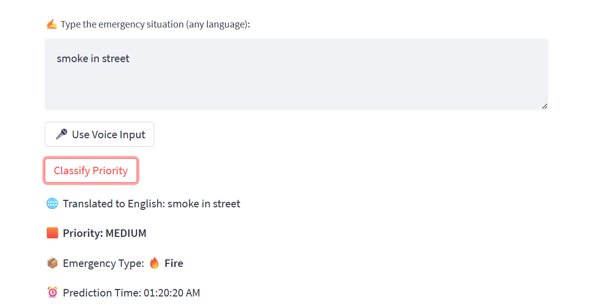
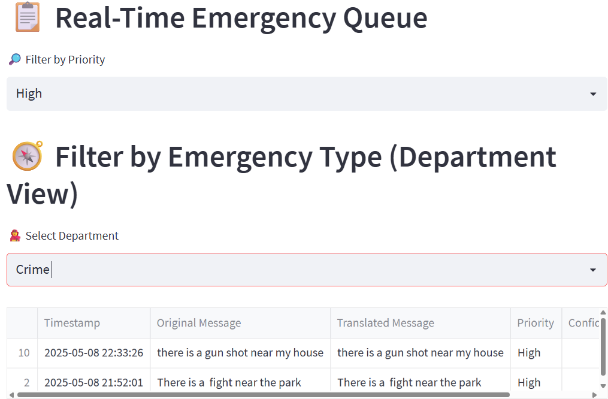
Implementation & Results of Module

Slide 12
Conclusion & Future Work
Conclusion: This system demonstrates the potential of AI to triage emergency calls intelligently. It supports multilingual, real-time interaction and improves the reliability of emergency classification.
Future Scope:
Integrate with national 112/108 emergency dispatch systems.
OTP-based verification before alerts are sent.
Add facial expression analysis for on-site photo uploads.
Department-wise dashboards (Police, Medical, Fire).
Implement deeper NLP with BERT or GPT models.

Slide 13
References
Smith, J., Johnson, A., & Lee, K. (2022). AI-Based Emergency Call Routing using Natural Language Understanding. IEEE Access, 10, 55678–55690.
Haider, S., & Shafiq, M. (2021). Speech Emotion Recognition for Emergency Prioritization. Journal of Intelligent & Fuzzy Systems, 40(5), 10823–10831.
Ramesh, A., & Thomas, V. (2020). Real-Time Emergency Classification using Naive Bayes and GPS Integration. International Journal of Computer Applications, 178(7), 15–20.
Li, Y., & Wang, Z. (2021). Location-aware NLP Models for Emergency Texts. ACM Transactions on Information Systems, 39(3), Article 25.
Sharma, N., & Patil, D. (2020). Multi-lingual Text Classification for Real-Time Safety Applications. Springer Nature, Advances in AI, 15(2), 211–225.
Shorten, C., & Khoshgoftaar, T. M. (2019). A Survey on Image and Text Data Augmentation for Deep Learning. Journal of Big Data, 6(1), 60.
Prasad, R., & Mehta, N. (2022). GPS and Real-Time Alert Integration for Urban Emergency Services. Elsevier – Computers, Environment and Urban Systems, 92, 101749.
Osei, C. J., & Yang, X. (2021). Browser-Based Location Capture using JavaScript APIs for Emergency Response. ACM Digital Library, Proceedings of WebConf.

Slide 14
Paper Publication Status
This project is being prepared for submission to the IEEE International Conference on Intelligent Systems and Smart Applications (ICISSA 2024).
Target title: AI-Based Emergency Call Prioritization Using NLP and Location Intelligence
Scope Fit: ICISSA focuses on AI-driven systems, smart city infrastructure, and real-time intelligent services, aligning closely with our project domain.
Current Stage:
The full implementation is complete, including system testing with 100+ multilingual emergency messages.
Experimental evaluation of the classifier (Multinomial Naive Bayes) has shown strong accuracy (~90.5%) for classifying emergency types and priorities.
Diagrams, dataset summary, architectural design, and result analysis sections have been finalized.
Abstract, introduction, and literature review have been drafted.
Publishing Goals:
Upon acceptance, the paper will be published in IEEE Xplore Digital Library.
The work will be presented during the technical sessions of the conference.
Co-authorship will be shared among student contributors and the supervising faculty.

Slide 15
Thank You

